Slide 1
UML Modeling
Instructor: Muhammad Zeeshan Nazar

Slide 2
How are design ideas communicated in a team environment?
If the software is large scale, employing perhaps dozens of developers over several years, it is important that all members of the development team communicate using a common language.
This isn’t meant to imply that they all need to be fluent in English or C++, but it does mean that they need to be able to describe their software’s operation and design to another person.
That is, the ideas in the head of say the analyst have to be conveyed to the designer in some way so that he/she can implement that idea in code.
Just as mathematicians use algebra and electronics engineers have evolved circuit notation and theory to describe their ideas, software engineers have evolved their own notation for describing the architecture and behaviour of software system.
That notation is called UML. The Unified Modelling Language. Some might prefer the title Universal Modelling language since it can be used to model many things besides software.

Slide 3
What is UML ?
UML is not a language in the same way that we view programming languages such as C++, Java or Python.
UML is however a language in the sense that it has syntax and semantics which convey meaning, understanding and constraints to the reader and thereby allows two people fluent in that language to communicate and understand the intention of the other.
UML represents a collection of graphical notations to capture requirements and design alternatives.
UML is to software engineers what building plans are to an architect and an electrical circuit diagrams is to an electrician.
UML is suitable for large scale projects
Notes:
Note: UML does not work well for small projects or projects where just a few developers are involved. If you attempt to use it in this environment it will seem more of a burden than an aid, but then it was never intended for that. It works best for very complex systems involving dozens of developers over a long period of time where it is impossible for one or two people to maintain the structure of the software in their head as they develop it.

Slide 4
Models and Multiple Views
UML is used to model (i.e., represent) the system being built.
It is impossible to capture all the subtle details of a complex software system in just one large diagram.
The UML has numerous types of diagrams, each providing a certain view of your system

Slide 5
Diagram Taxonomy
UML diagrams can be classified into two groups: structure diagrams and behavior diagrams.
System complexity is driven both by the number and organization of elements in the system (i.e., structure) and the way all these elements collaborate to perform their function (i.e., behavior).

Slide 6
Structure Diagrams
These diagrams are used to show the static structure of elements in the system, architectural organization of the system, the physical elements of the system, its runtime configuration.
Structure diagrams are often used in conjunction with behavior diagrams to depict a particular aspect of your system. Each class may have an associated state machine diagram that indicates the event-driven behavior of the class’s instances.
Following are the Structure Diagrams in UML:
■ Package diagram
■ Class diagram
■ Component diagram
■ Deployment diagram
■ Object diagram
■ Composite structure diagram

Slide 7
Behavior Diagrams
Events happen dynamically in all software-intensive systems: Objects are created and destroyed, objects send messages to one another in an orderly fashion, external events trigger operations on certain objects.
Following are the Behavior Diagrams in UML:
■ Use case diagram
■ Activity diagram
■ State machine diagram
■ Interaction diagrams
■ Sequence diagram
■ Communication diagram
■ Interaction overview diagram
■ Timing diagram

Slide 8
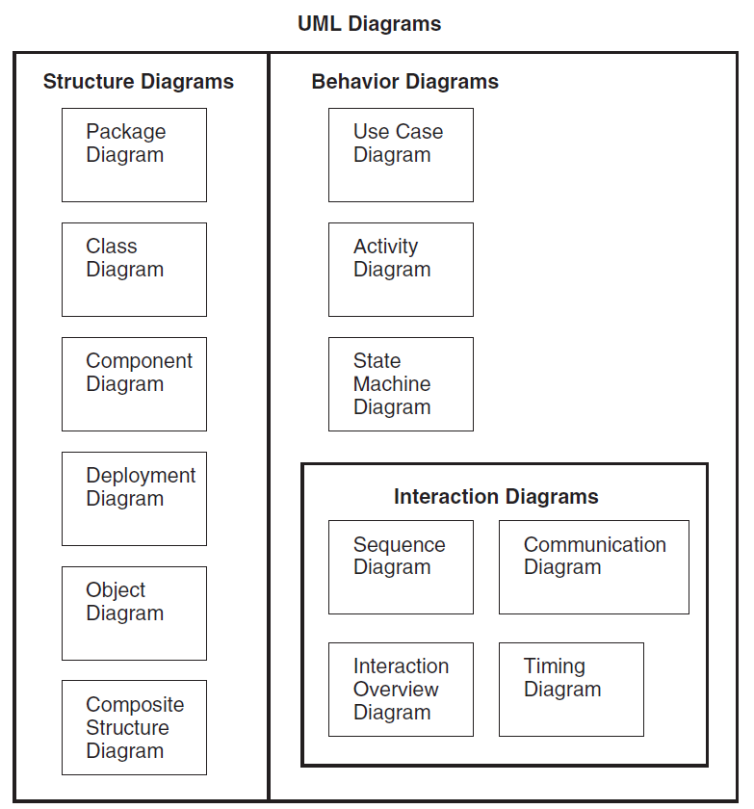
UML Diagrams

Slide 9
Definition of a Use-Case
A process or procedure, describing a user’s interaction with the system (e.g. library) for a specified, identifiable purpose. (e.g. borrowing a book).
As such, each Use-Case describes a step-by-step sequence of operations, iterations and events that document
The Interaction taking place.
The Measurable Benefits to the user interacting with the system
The Effect of that Interaction on the system.
It is important to document these use-cases as fully as possible as each use-case captures some important functionality that our system will have to provide.
Notes:
Each use case represents a discrete goal for the user

Slide 10
Use Cases in Iterative Development
Functional requirements are primarily captured in use cases
Use cases drive the iteration planning and work
Easy for users to understand

Slide 11
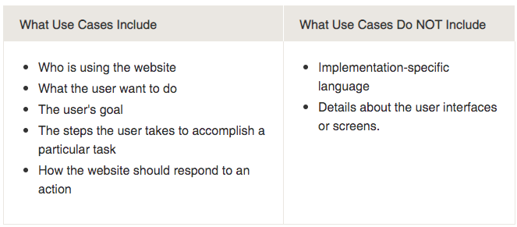
What ‘should’ and what ‘shouldn’t ‘ be included in use cases?

Slide 12
How to Find Use Cases?
Choose the system boundary
what you are building?
who will be using the system?
what else will be used that you are not building?
Find primary actors and their goals
brainstorm the primary actors first who starts and stops the system?
who gets notified when there are errors or failures?
Define use cases that satisfy user goals
prepare an actor-goal list in general, one use case for each user goal
name the use case similar to the user goal

Slide 13
What Tests Can Help Find Useful Use Cases?
Which of these are valid use cases?
Negotiate a Supplier Contract
Handle Returns
Log in
Move Piece on the Game Board
All of these can be use cases at different levels,
depending on the system, boundary, actors, and goals

Slide 14

What Tests Can Help Find Useful Use Cases?
Rather than asking ”What is a valid use case?”
More practical question:
“What is a useful use case?”
Rules of thumb
The Boss Test
The EBP Test
The size test

Slide 15
What Tests Can Help Find Useful Use Cases?
Boss test
“What have you been doing all day?”
Your reply “logging in!”
Is your boss happy? No value? No good use case!
Elementary Business Process (EBP) test
A task performed by one person in one place at one time, in response to a business event, which adds measurable business value and leaves data in a consistent state
Good Examples: Approve Credit or Price Order
Bad Examples: Delete a line item or print the document
Size test
Just a single step in a sequence of others -> not good!
Example: Enter an Item Id
Notes:
Doesn’t mean to always ignore boss-test-failing use cases. User authentication may fail the boss test but may be important and difficult.
EBP Test: It’s not a single small step like “delete a line item” or “print the document.” Rather, the main success scenario is probably five or ten steps. It doesn’t take days and multiple sessions, like “negotiate a supplier contract”; it is a task done during a single session. It is probably between a few minutes and an hour in length.
Size Test: A common mistake in use case modeling is to define just a single step within a series of related steps as a use case by itself, such as defining a use case called Enter an Item ID. You can see a hint of the error by its small size—the use case name will wrongly suggest just one step within a larger series of steps

Slide 16
Applying Tests
Handle returns
OK with the Boss. EBP. Size is good.
Log in
Boss is not happy is this is all you do all day!
Move piece on game board
Single step – fails the size test.

Slide 17
Use Case Diagram Concepts
Summarizes all use cases (for the part of the system being modeled) together in one picture
Typically drawn early in the SDLC
Shows the associations between actors and use cases

Slide 18

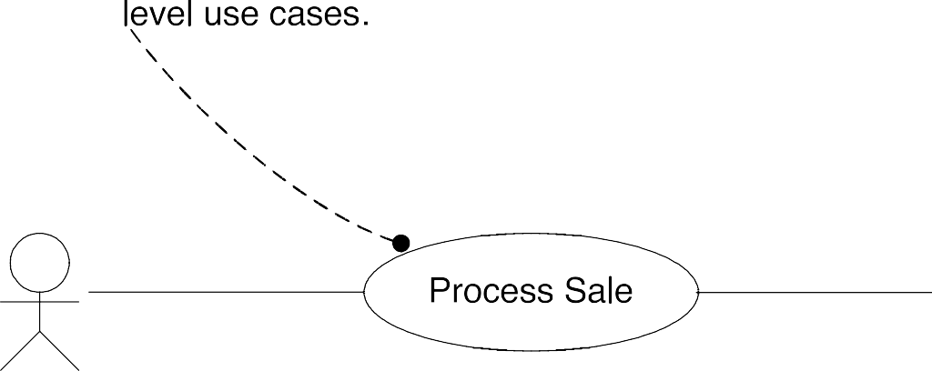

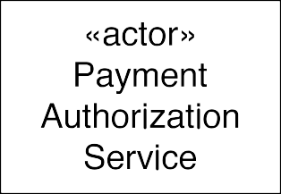

Use Case (Context) Diagrams: Suggested Notation
secondary/supporting actors on the right
Notes:
The users or systems that interact with the main system are called actors. An actor can be primary or secondary. Primary actors are those that initiate use cases and interact with the system. They are usually placed on the left side of the system. On the other hand, secondary actors are used by the system but they do not interact with the system on their own.

Slide 19
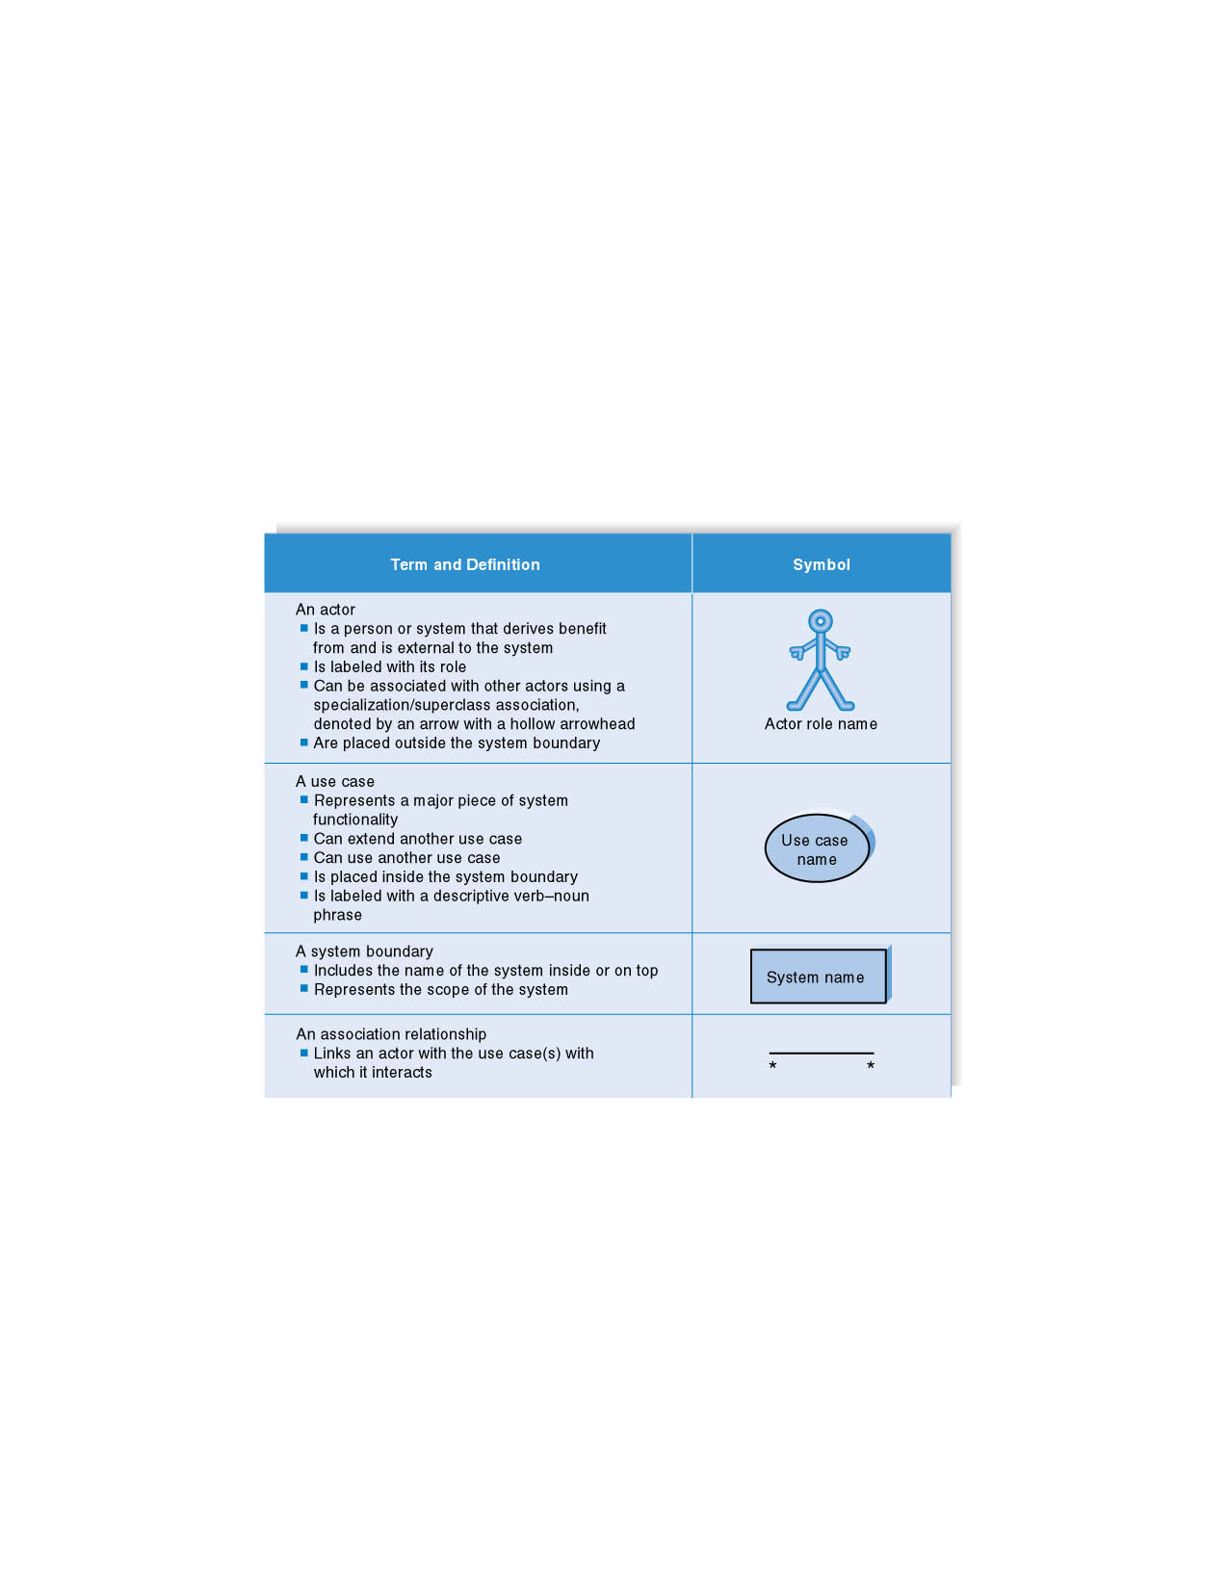

Syntax for Use Case Diagram
Notations
Name of the system

Slide 20
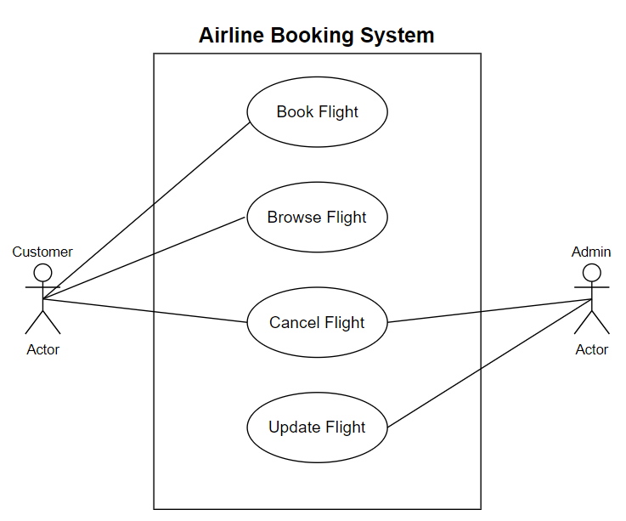
Use Case Diagram for Airline Booking System
Secondary Actor
Primary Actor

Slide 21
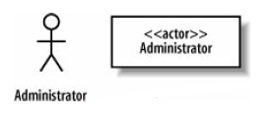
Example
The requirement indicates that that the Administrator interacts with the system to create a new blogger's account
Requirement 1
The content management system shall allow an administrator to create a new blog account, provided the personal details of the new blogger are verified using the author credentials database.
The
Administrator interacts with the system and is not part of the system; thus, the Administrator
Is an Actor.
It's actually worth being very careful when naming your actors. The best approach is to use a name that can be understood by both your customer and your system designers.

Slide 22

Example
What can be the use case in our Requirement 1?
to create a new blog account
Requirement 1
The content management system shall allow an administrator to create a new blog account, provided the personal details of the new blogger are verified using the author credentials database.
UML Representation

Slide 23
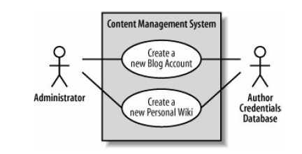
Example (Cont)
Requirement 2
The content management system shall allow an administrator to create a new personal Wiki, provided the personal details of the applying author are verified using the Author Credentials Database.

Slide 24
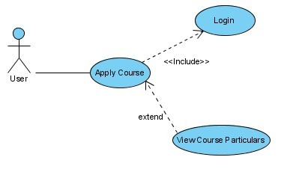
Example of Stereotypes – Include and Extend
Slide 2 (of 48)
Notes:
When a use case is depicted as using the functionality of another use case, the relationship between the use cases is named as include or uses relationship.
In UML modeling, you can use an extend relationship to specify that one use case (extension) extends the behavior of another use case (base).

Slide 25
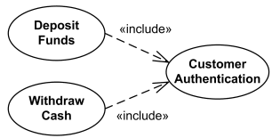
Example – Include and Extend
User
Slide 2 (of 48)

Slide 26
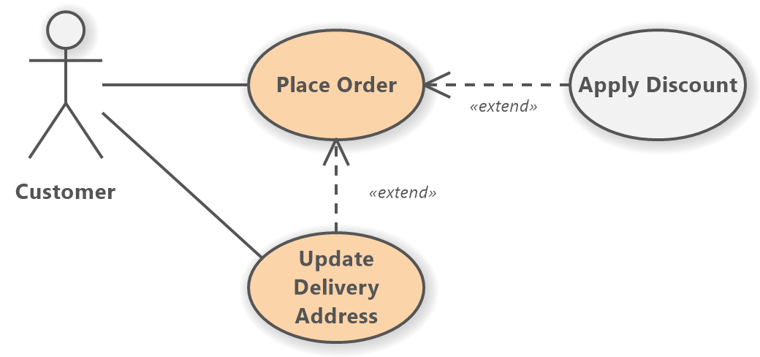
Example – Include and Extend
Slide 2 (of 48)

Slide 27
Include and Extend Relationships
The use of include and extend is discouraged simply because they add unnecessary complexity to a Use Case diagram.
Only use them if they are necessary.
Slide 2 (of 48)

Slide 28
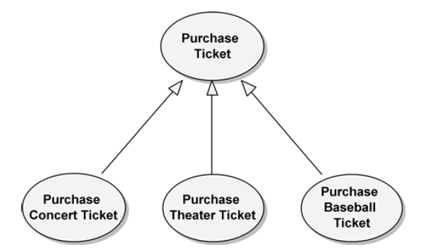
Generalization
Generalization relationships can also be used to relate use cases. As with classes, use cases can have common behaviors that other use cases (i.e., child use cases) can modify by adding steps or refining others.
Purchase Ticket contains the basic steps necessary for purchasing any tickets, while the child use cases specialize Purchase Ticket for the specific kinds of tickets being purchased.

Slide 29
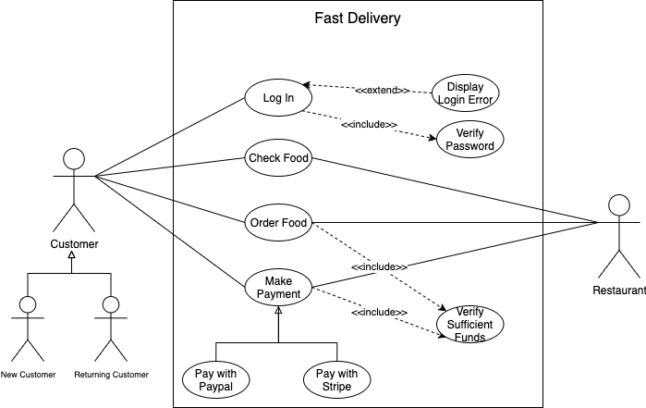
Example

Slide 30
Use Case Diagram– Guidelines & Caution
Actors should be Nouns
Use cases should ideally begin with a verb – i.e. generate report.
Use cases should NOT be open ended – i.e. Register (instead should be named as Register New User)
Avoid showing communication between actors.
named as singular. i.e., student and NOT students. NO names should be used – i.e., John, Sam, etc.
Do NOT show behavior in a use case diagram instead only depict system functionality.
Use case diagram does not show sequence – unlike DFDs.

Slide 31
Granularity of Use Cases
Add reference
Remove reference
User
Search for reference
List references

Slide 32
Granularity of Use Cases
Manage Reference
User
Generally, a use case should embody sufficient levels of granularity without which the use case may not be rendered as useful.

Slide 33
Case
Identify Actors
Driver and hostess cannot be an Actor. Why?
Driver
Hostess
Customer
Company Staff/ Administrator
Consider an online reservation system for a bus company. The bus company includes several buses and manage trips to different cities. Each bus is identified by its plate number and a separately assigned bus number. The trips are based on a predefined schedule and stop at predefined bus stations. Each bus can have only one trip per day. Each bus includes a driver and one hostess. For long trips, the bus will have breaks at service and rest areas. There are two types of trips, normal trips and express trips. Express trips do not stop at intermediate stations and get faster at the destination. Seats can be reserved by customers on the web site of the bus company. The customer has the option to directly pay for the seat through the website. In that case, the seat cannot be cancelled (neither by the customer nor by the bus company). If the customer has not paid for the seat, the bus company can cancel the seat if the customer does not show up one hour before the trip. When the reservation is cancelled, the seat will become free and can be sold to another customer. Both the customer and the company staff must register themselves for performing operations with the system.

Slide 34
Case
Identify Verb / Goal/Use Case
Reserve Seat
Pay for the Seat
Cancel Seat
Register
View Seat
Consider an online reservation system for a bus company. The bus company includes several buses and realizes trips to different cities. Each bus is identified by its plate number and a separately assigned bus number. The trips are based on a predefined schedule and stop at predefined bus stations. Each bus can have only one trip per day. Each bus includes a driver and one hostess. For long trips, the bus will have breaks at service and rest areas. There are two types of trips, normal trips and express trips. Express trips do not stop at intermediate stations and get faster at the destination. Seats can be reserved by customers on the web site of the bus company. The customer has the option to directly pay for the seat through the website. In that case, the seat cannot be cancelled (neither by the customer nor by the bus company). If the customer has not paid for the seat, the bus company can cancel the seat if the customer does not show up one hour before the trip. When the reservation is cancelled, the seat will become free and can be sold to another customer. Both the customer and the company staff must register themselves for performing operations with the system.

Slide 35
So far what we have done
Actors
Customer
Bus Company Administrator
Use Cases
Reserve Seat
Pay for the Seat
Cancel Seat
Register
View Seat
Start Making a Use Case Diagram with the identified infromation

Slide 36
Case
Actor Goals?
Complete the Use Case Diagram
Customer Reserves the Seat
Customer Pays for the Seat
Customer & Admin Cancels the Seat
Customer & Admin must Register
Customer & Admin can View the Seat
Consider an online reservation system for a bus company. The bus company includes several buses and realizes trips to different cities. Each bus is identified by its plate number and a separately assigned bus number. The trips are based on a predefined schedule and stop at predefined bus stations. Each bus can have only one trip per day. Each bus includes a driver and one hostess. For long trips, the bus will have breaks at service and rest areas. There are two types of trips, normal trips and express trips. Express trips do not stop at intermediate stations and get faster at the destination. Seats can be reserved by customers on the web site of the bus company. The customer has the option to directly pay for the seat through the website. In that case, the seat cannot be cancelled (neither by the customer nor by the bus company). If the customer has not paid for the seat, the bus company can cancel the seat if the customer does not show up one hour before the trip. When the reservation is cancelled, the seat will become free and can be sold to another customer. Both the customer and the company staff must register themselves for performing operations with the system.

Slide 37

One Possible Solution for the Case
Bus Reservation System
Reserve Seat
Pay for Seat
Customer
Cancel Seat
Register
Bus Company Admin
View Seats

Slide 38
Case Study: Point of Sale terminal

Slide 39
Case Study: Point of Sale terminal
Process Sale:
A customer arrives at a checkout with items to purchase.
The cashier uses the POS system to record each purchased item.
The system presents a running total and line-item details.
The customer enters payment information, which the system validates and records.
The system updates inventory.
The customer receives a receipt from the system and then leaves with the items.

Slide 40
Recall: Procedure to Find Use Cases
Step 1: Choose the system boundary
Step 2: Identify the primary actors
Step 3: Identify Actor (User) Goals
Step 4: Define use cases
Software application,
The hardware and application as a unit
An entire organization, or a dept of the org
Those having user goals fulfilled through using services of the system.
For each (primary actors), identify their user goals.
Use cases that satisfy user goals.
Name them according to their goal.

Slide 41
Step 1: Choosing the System Boundary
POS system itself is the System Boundary;
every-thing outside of it is outside the system boundary, including the cashier, payment authorization services, and so on.
Once the external actors are identified, the boundary becomes clearer.
For example, is the complete responsibility for payment authorization within the system boundary? No, there is an external payment authorization service actor.

Slide 42
Step 2: Identify Actors
We cannot understand a system until we know who will use it
Direct users
Users responsible to operate and maintain it
External systems used by the system
External systems that interact with the system

Slide 43
Actors in POS
Cashier
Manager
System Administrator
Sales Activity System

Slide 44
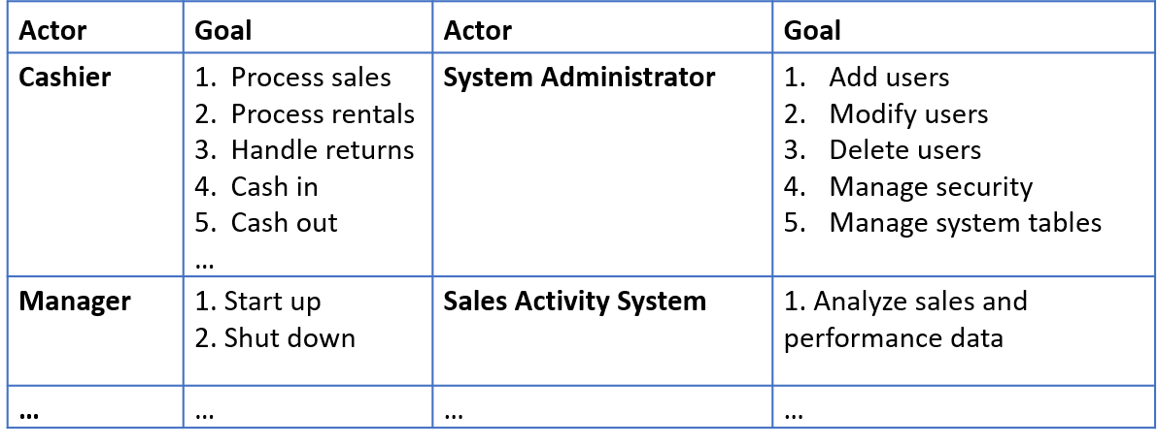
Step 3: Actors and User Goals List

Slide 45
Step 4: Define Use Cases
In general, define one use case for each user goal.
Granularity: An exception to one use case per goal is to collapse CRUD (create, retrieve, update, delete) separate goals into one CRUD use case, idiomatically called Manage <X>. For example, the goals ―edit user,―delete user and so forth are all satisfied by the Manage Users use case.
Name the use case similar to the user goal (e.g., Goal: process a sale; Use Case: Process Sale.
Start the name of use cases with a verb

Slide 46
Write Black-Box Use Cases
Focus on what the system must do,
i.e., the behavior or functional requirements
Not on how it will do (the design)
Examples:
Good: The system records the sale
Bad: The system writes the sale to the database.
Worst: System generates SQL INSERT statement for the sale

Slide 47
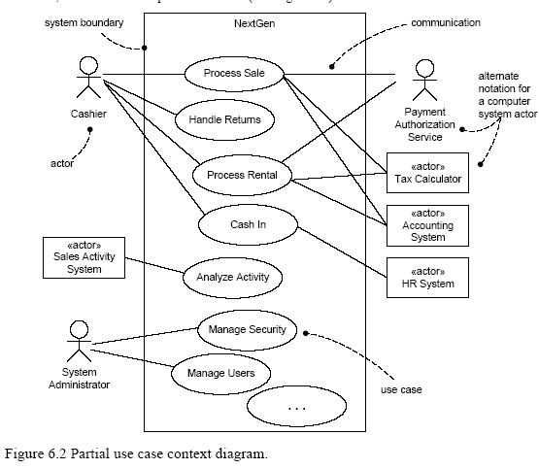
Use Case Diagram of POS System

Slide 48
Use Case Diagram
A use case diagram for the entire system – a graphic model.
Use cases are not diagrams they are text documents.
Use cases are one way of capturing the functional requirements.
Use cases are text stories of some actors using a system to meet goals.
One or more use case narratives for each use case – descriptions in text
high-level/user story
expanded

Slide 49
Use Case Description Template
Identifier |  |  | Give a unique Identifier for the Use Case
Name |  |  | Write the name of use case
Purpose |  |  | Brief Description of the process (what is happening?) in the use case
Priority |  |  | High/Medium/Low
Actors |  |  | List all actors (people, systems etc.) associated with this requirement
Pre-conditions |  |  | What must occur before the use case begins
Post-conditions |  |  | What has occurred as a result of the use case
Dependencies |  |  | List identifiers of use cases on which this use case is dependent
Typical Course of Action (Primary Flow)
S# | Actor Action | Actor Action |  | S# | System Response
1 | List the actor steps here | List the actor steps here |  | 1.1 | List the system steps here
2 |  |  |  | 2.1
Alternative Course of Action
S# |  | Actor Action |  | S# | System Response
1 |  | List the actor steps here |  | 1.1 | List the system steps here
Exceptions: List the sequence of actions that prevents getting to the post condition
Notes:
Primary Flow: Description of the sequence of activities in the most commonly completed path or flow. It is the most routine path from pre to post conditions.
Alternate Course of Action: List the less common sequences that get to the post conditions

Slide 50
Identifier |  | UC-01
Name |  | Process Customer Order
Purpose |  | This use case describes the procedure for processing a customer's order, from placing the order to confirming the payment and shipment.
Priority |  | High
Actors |  | Customer, Payment Gateway, Warehouse System
Pre-conditions |  | 1 - The Customer Account should exist. 2 - The Customer is logged in. 3 - The items to be purchased are in stock. 4 - The Payment Gateway is operational.
Post-conditions |  | The order is placed, payment is confirmed, and the warehouse is notified to ship the items.
Dependencies |  | Integration with Payment Gateway and Warehouse System.
Typical Course of Action (Primary Flow)
S# | Actor Action |  | S# | System Response
1 | Select items to purchase and proceed to checkout. |  | 1.1 | Display the order summary page.
2 | Review order and click "Place Order." |  | 2.1 | Initiate the payment process by redirecting to the Payment Gateway.
3 | Enter payment details and confirm payment. |  | 3.1 | Verify payment information with the Payment Gateway.
 |  |  | 3.2 | Upon successful payment, save the order to the database.
 |  |  | 3.3 | Notify the Warehouse System to prepare the order for shipment.
 |  |  | 3.4 | Display an order confirmation message and send a confirmation email to the Customer.

Slide 51
Alternative Course of Action
S# | Actor Action | S# | System Response
1 | Select items to purchase but decides to edit the cart. | 1.1 | Allow the Customer to modify the cart and update the order summary.
2 | Proceed to checkout after editing. | 2.1 | Display the updated order summary page and continue with the normal flow.
Exceptions Payment Failure: If the payment fails, display an error message and prompt the Customer to retry the payment or choose a different payment method. The order is not saved until the payment is successful. Out of Stock: If an item goes out of stock during checkout, notify the Customer and allow them to either remove the item from the cart or choose a different item before proceeding. System Error: If there is a system error during order processing, an error message is displayed, and the order is not placed. The Customer is prompted to retry later.

Slide 52
References
Object-Oriented Analysis and Design with Applications, Grady Booch et al., 3rd Edition, Pearson, 2007.
Timothy C. Lethbridge, Robert Laganaiere, Object-Oriented Software Engineering (2nd Edition), McGraw Hill, 2005
Object-Oriented Modeling and Design with UML, Michael R. Blaha and James R. Rumbaugh, 2nd Edition, Pearson, 2005.
Larman, Craig. Applying UML and patterns: an introduction to object oriented analysis and design and interative development. Pearson Education India, 2012.

